Slide 1
Light saver app
Mobile app project

Slide 2

Problem to solve
Develop a mobile application that can connect to a sensor and actuator to perform a desired activity that can be useful for the user.

Slide 3
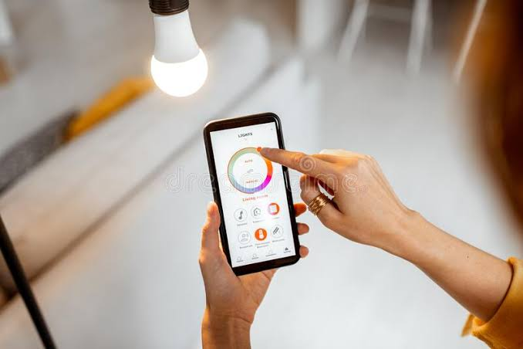
Description
Develop a mobile application that can read a light sensor and can determine the best time to turn on/turn off one or many light bulbs.

Slide 4

Material to use
Application developed for android user.
Light sensor
Relays
Bulbs

Slide 5
User Stories
As user | change light time notification | To control my desired hour to save energy
As user | turn on light bulbs | to have light
As user | turn off ligth bulbs | to save enrgy
As user | control light intesity | to make it more bright
As user | add bulbs switches | to have independent light bulbs

